Slide 1
Advanced Angular using ReactiveX and Redux
Kobi Hari hari@applicolors.com

Slide 2

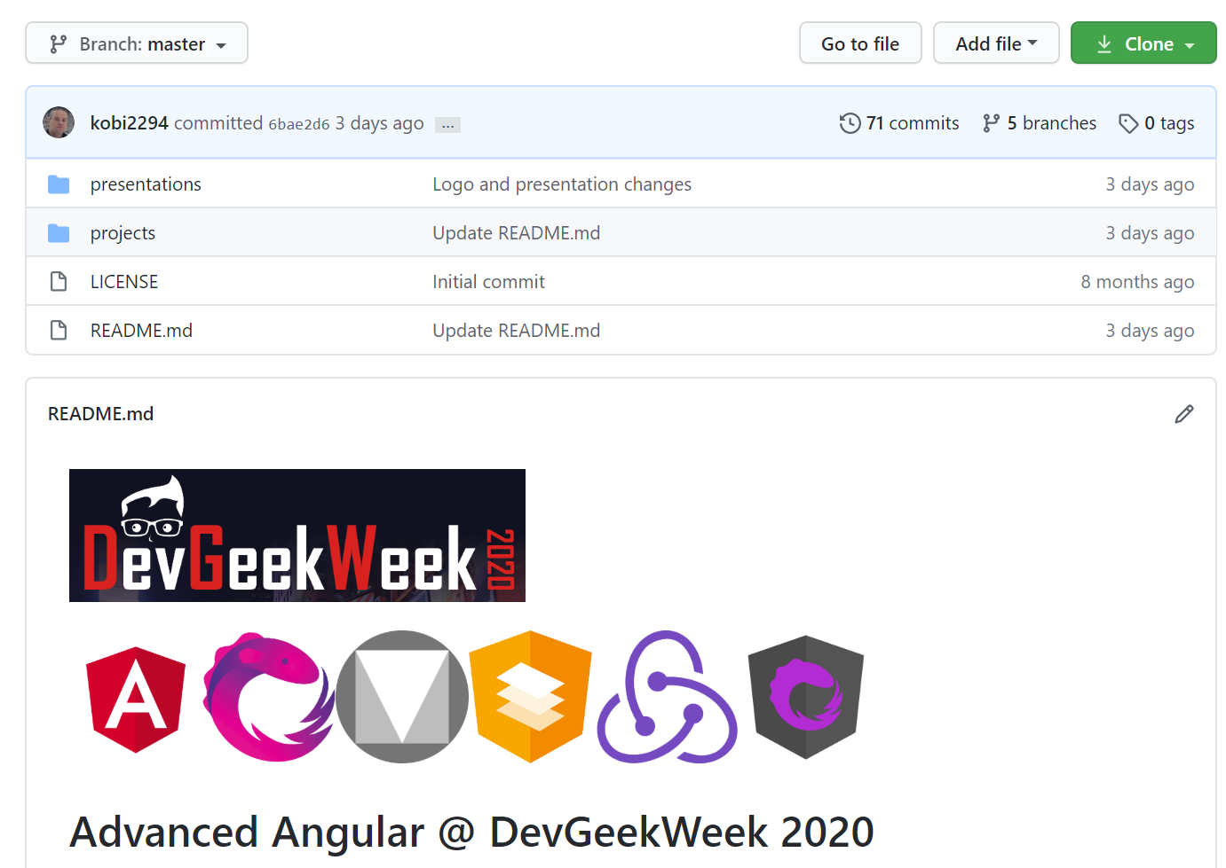
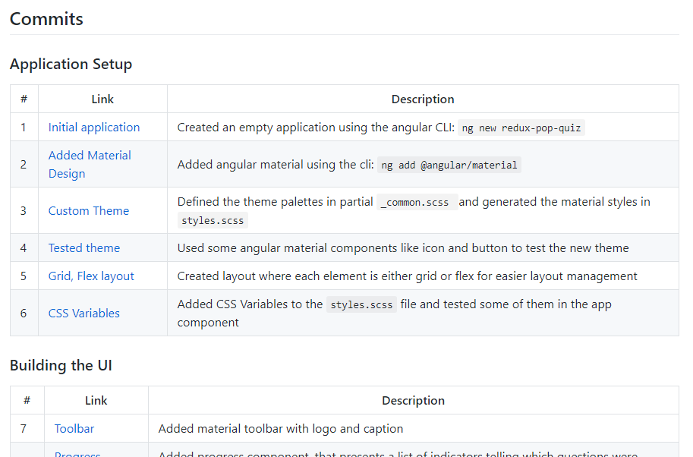
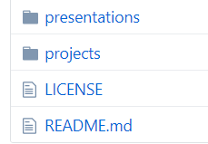

We have a GitHub Repository!
Kobi2294/DevGeekWeek2020-Angular
Session Summary
Project Code with Commits Summary
This presentation
Useful Links
A video with the Main Demo

Slide 3






Our Agenda:
In angular
Using…
Reactive X
RxJS
In angular
Using…
Material
Design
Angular Material
In angular
Using…
Redux
NgRx/Store

Slide 4

Reactive X

Slide 5
Rx - Motivation
Mostly useful when using single point of data with multiple consumers
The traditional solution to this is using method invocation to pull data
There are several problems with this approach:
Redundancy - Multiple method invocation to “calculate” the same data
Synchronization – When should each consumer ask for data
Reactive X moves the initiative to the producer. Instead of being asked for data, it pushes it to the consumer.
The producer Acts, the consumer Re-acts.
Hence Reactive…

Slide 6
Some Buzzwords
Observer Pattern
Iterator Pattern
Asynchronous Development

Slide 7
Streams
A Stream is a sequence of events describing the state of a single data over time.
Streams may end successfully
Streams may end in failure
Streams may never end…

Slide 8
Observers
An Observer<T> is an object that get’s notified regarding a stream of <T>. Notifications are done using the following methods
Next(value: T) | called to notify the observer of the new value of the data
Complete() | called to indicate that the stream is over – so the value will no longer change
Error(err: any) | called to indicate that there is something wrong with the stream – and that there will be no more events, but for a bad reason
Of course, Observer<T> is an interface to be implemented so your object may be called about a stream.

Slide 9
Observable<T>
An Observable<T> is an object that allows multiple Observers<T> to subscribe.
Subscribe(observer: Observer<T>) | Subscribe another observer

Slide 10
Warm and Cold Observables
An Observable is lazy
It does not really start unless you subscribe.
In fact – the only logic you can provide into an observable is on the subscribe callback
A “Cold” Observable is an that relies on subscribers to start producing events
A “Warm” Observable produces the same events regardless of subscriptions

Slide 11

DEMO
Observables

Slide 12
Demo Conclusions:
You can not run any logic in an observable, except that one that decides how to treat new observers when they subscribe.
This is the only way to access observers and raise events.
Cold Observables will only execute when they are subscribed to.
And they will re-execute every time they are subscribed again.

Slide 13

Is it like promises?
Well yes and no.
A promise is like an observable that only throws one next, and always throws complete right after the single next.
In a way – love (rxjs) is a promise that lasts forever 😊
Oh and promises are not lazy… they run code as soon as the promise is created even if it is never listened to. (“then”-ed to)

Slide 14
Observables may send different events to each observer
Accessing an observer is possible only in the constructor
A constructed observer is “read only”. You can subscribe to it, but you can not emit events

Slide 15
Subjects
A Subject is an observable that allows you to emit events.
It is both an Observable and an Observer at the same time
Subject
Next
Complete
Subscribe
Error
When you call “next”, “complete” or “error”, it sends the event to all subscribed observers
In a way, it is like a writeable observable
Is it a “cold” or “warm” observable?

Slide 16
Behavior Subject
BehaviorSubject<T> extends Subject<T>
When subscribed to, it emits the latest event to the subscriber
Ideal for storing variable state
Requires an initial value on constructor (why?)
Has a Value property you can use to get the value of the latest event.

Slide 17
DEMO
Subjects

Slide 18

Unsubscribe !
Consider a specific scenario
Single service
Component subscribes to service
Component gets destroyed and re-created many times
Service observable now points to component (in the callback)
It accumulates callbacks
Memory leaks
Probably even more problematic: performance leaks
Possibly also – problematic responses to changes
Some services do not require unsubscribe:
http
activatedRoute

Slide 19
Async Pipe
A new method of development where you bind directly to the observables in the component.
It Subscribes and Unsubscribes for you – which avoids memory leaks
Also works with promises

Slide 20
DEMO
async pipe & operators

Slide 21
Material Design
with
@angular/material
+
=
Material Design
Angular
Angular Material

Slide 22
Material Design
A set of well-defined design guidelines
Developed by Google on 2014
Summarized in a detail web site: https://material.io/design/
Defines:
Color system (themes and palettes)
Icons
Fonts
Standard Margins, shadows, and corner radiuses
Animations
A set of component designs

Slide 23
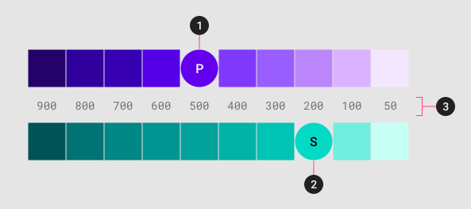
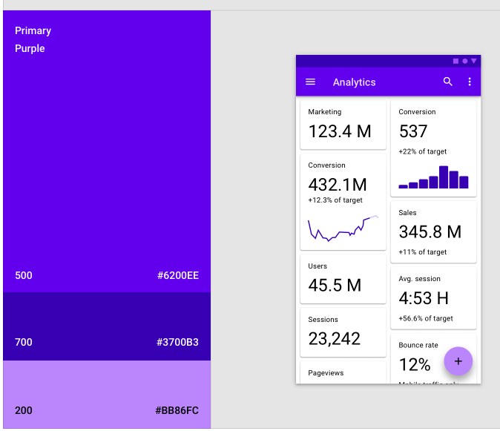
The Color System
Themes are defined using:
A primary color palette
A Secondary (accent) color palette
Dark / Light
The 3 parameters yield a set of reusable colors:

Slide 24
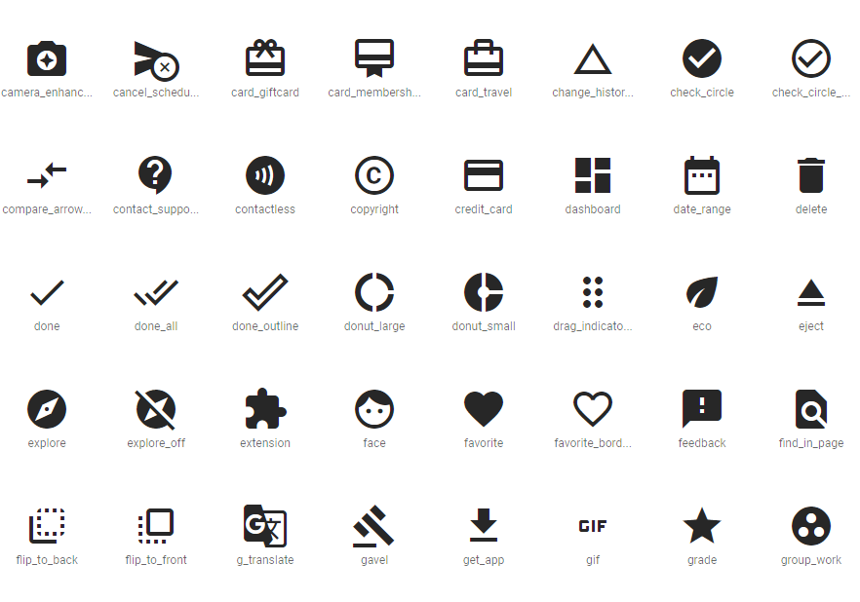
Icons
Material Design defines how icons are to be created
It also comes with a (large) set of predefined icons

Slide 25
Angular Material
An implementation of Material Design as Angular Components.
Uses Sass to define themes and standard classes.
Uses another package called “CDK” to develop the components
We are also able to use the same package to extend the components library

Slide 26
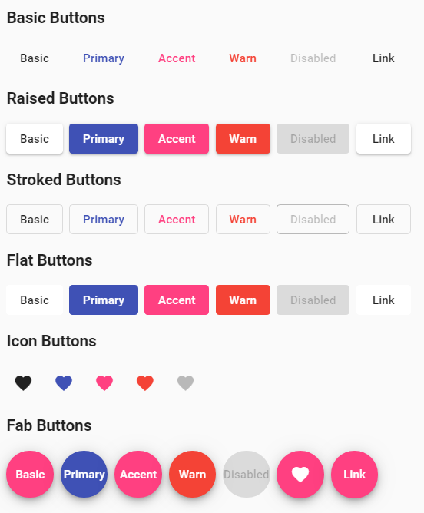
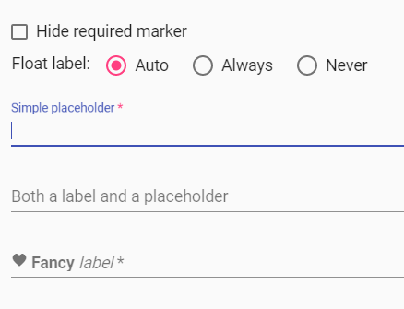
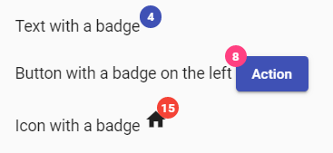
Angular Material
Includes a large set of the “Material Design” Components including:
Form Controls
Cards and other layout components
Buttons and Indicators
Supports popups and dialogs

Slide 27
DEMO
Building UI

Slide 28



Redux
with
@ngrx/store
+
+
=
Redux
RxJS
Angular
NgRX

Slide 29
Our Goal
Understand Redux
Understand how to combine Redux with Angular
Understand how combining the two can improve performance

Slide 30
Our Objective
Following our Redux lesson, our objective:
Create a Popup Quiz app
Entire app with chage detection strategy OnPush

Slide 31
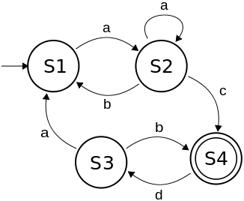
What is a State
In college at automation course we learned about Finite-state machine (FSA)
FSA is a mathematical model of computation
FSA can be in one state out of a group of final states at any given time
FSA can transition to a new state based on certain change in input
Can we look at our frontend application as an FSA?
What can be the cause of a transition in state in a frontend web app?

Slide 32
Todo App State
In our todo app we have a component that displays the list of todo items
At the beginning, the list is empty and we query the server for the list of items
After the server return our response we display the list of tasks
The todo list component looks like this:
Todo Item 1
Todo Item 2
Todo Item 3
Todo Item 4
This list is from the server

Slide 33

What is Redux
Predictable state container for JS apps
Using redux we have a single object holding the state of our app which is called store
The state in the store can be an Object, Array, Primitive but it’s highly recommended that it will be immutable
The only way to change the state is by calling a method on the store called dispatch
store.dispatch(action)
An action is a simple object describing what happened
The store decides how the state will change using a pure function called reducer
The reducer answers the questions How does the state change?
(state, action) => state

Slide 34
Redux Core
Redux core concepts are:
Actions
Reducers
Store
Old State
Reducer
New State
Action

Slide 35
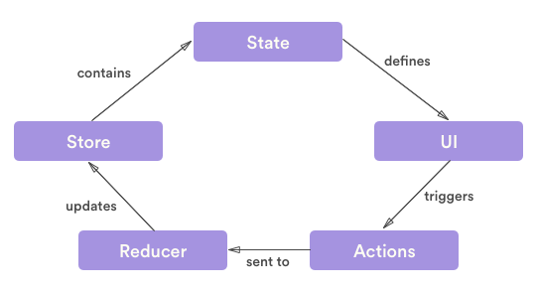

Slide 36
Actions and Action creators
Action is a simple JS Object
The action needs to hold the following information
identifier of the action (string)
data associated with the action
example: {type: ‘SET_LOADING’, payload: true }
Action creator is a pure function which returns an action
The latest NgRx provides action creators
function setIsLoading(isLoading) {
return {type: ‘SET_LOADING’, payload: isLoading};
}
Which action creators do you think our Todo app requires?

Slide 37
Reducers
Reducers are functions that apply action to create a new state
Reducers are pure functions
Reducers get the current state and action as arguments
The reducer need to decide based on the action and the current state what the next state will be
The state has to be immutable.
When our state grows if we use only a single reducer the reducer will be huge so it is better to split the state to sections and also split the reducers
Redux has a function called combineReducers to help us split the app and make each reducer in charge of certain section of the state

Slide 38
combineReducers
When our state grows so will our single reducer
We want to split the state to logical sections
Let’s say our quiz application will need to hold information about the current user
We will create another reducer that will handle the user info and combine those reducers with the combineReducers function.
The latest NgRx has an alternative which is easier for lazy loaded feature modules

Slide 39
Store
there is a single store in redux application
the store holds the state of our app
to create the store we use createStore
createStore(reducers, initialState)
we need to pass to the createStore the combined reducers and optional initial state
Let’s create our store

Slide 40
Redux dev tools
one of the strong features of redux is the ease of testing and ease of development
you have a state and the app should behave according to the state
for development purpose it’s better if we can easily examine the current state and all the actions that got us to this state
there is an easy to use browser extension:
https://github.com/zalmoxisus/redux-devtools-extension
to install the devtool extension: ng add @ngrx/store-devtools

Slide 41
Combining with Angular
Now that we know what Redux is, lets try and combine Angular and redux together using @ngrx/store

Slide 42
What is @ngrx/store
state management for Angular applications inspired by redux
we select items from the state and get them as observables
we then use async pipe to display them in the components
async pipe will cause a re-render even if the component is in change strategy on push
install with ng add:
ng add @ngrx/store

Slide 43
Store as a Module
Similar to how we placed routing in separate modules, we will do the same with our state
Each module which needs to add items to our state will have that logic in a store module
app-store - will contain store module for the root module
user-store - will contain store module for the feature module called user
Inside each module we can split the reducers based on logical sections

Slide 44
Actions
Let’s start by implementing our actions
We will use the createAction function.
We will define the action payload using the props function.
We will also use typescript grouping to group them under a single alias

Slide 45
Selectors
Selectors are used to create pre-built reusable queries
We will use the createFeatureSelector function to create a selector that queries the entire “slice” or “feature” of the store.
We will use the createSelector function to create a selector that queries a specific piece of data from the store.
We will also use typescript grouping to group them under a single alias

Slide 46
Reducer
We will define an interface that describes the section of the state that the reducer is in charge of
We will define our initial state
Create our reducer as a pure function with using the “on” function.
The pure function will use the types defined in the action file

Slide 47
Store Module
We will call StoreModule.forRoot to create our store
It will get the reducer map we created before
For lazy loaded module their state will be lazy loaded as well and we will call the function StoreModule.forFeature
We will add our store module to the app module
We can now inject the store to our services and components

Slide 48
Components
Inject the store to the components
We can use the store.dispatch method to invoke actions.
We can use the store.select method to use selectors and create observables.
We will use the async pipe to display that observable

Slide 49
Summary
With redux we can manage the state of our app
The only way to change the state is by calling store.dispatch(action)
Reducers will decide how the state changes
As a best practice, we will use selectors to access the data using observables.
Combining Angular and redux is a powerful tool which gives us
More testable app
Better performance
Easier management of the data of our app

Slide 50
DEMO
Logic and Data using NgRx Store

